Slide 1
BIOE 498 / BIOE 599 Advanced Biological Control Systems Other Topics in Closed Loop Systems
Joseph L. Hellerstein
eScience Institute, Computer Science & Engineering
Allen School of Computer Science
BioEngineering
Notes:
Diverse students. Some with bio-backgrounds; some without. Some with CS background; some with very limited. Two separate courses combined because of a substantial shared curriculum.

Slide 2
Agenda
Filter design
Frequency design
Controllability
Observability
Optimal control
Model predictive control
State Observers
Adaptive control
Notes:
Survey of Closed Loop Systems. Optimal control. Model predictive control. Controllability. Observability. Observers. Adaptive control. Fuzzy control.

Slide 3
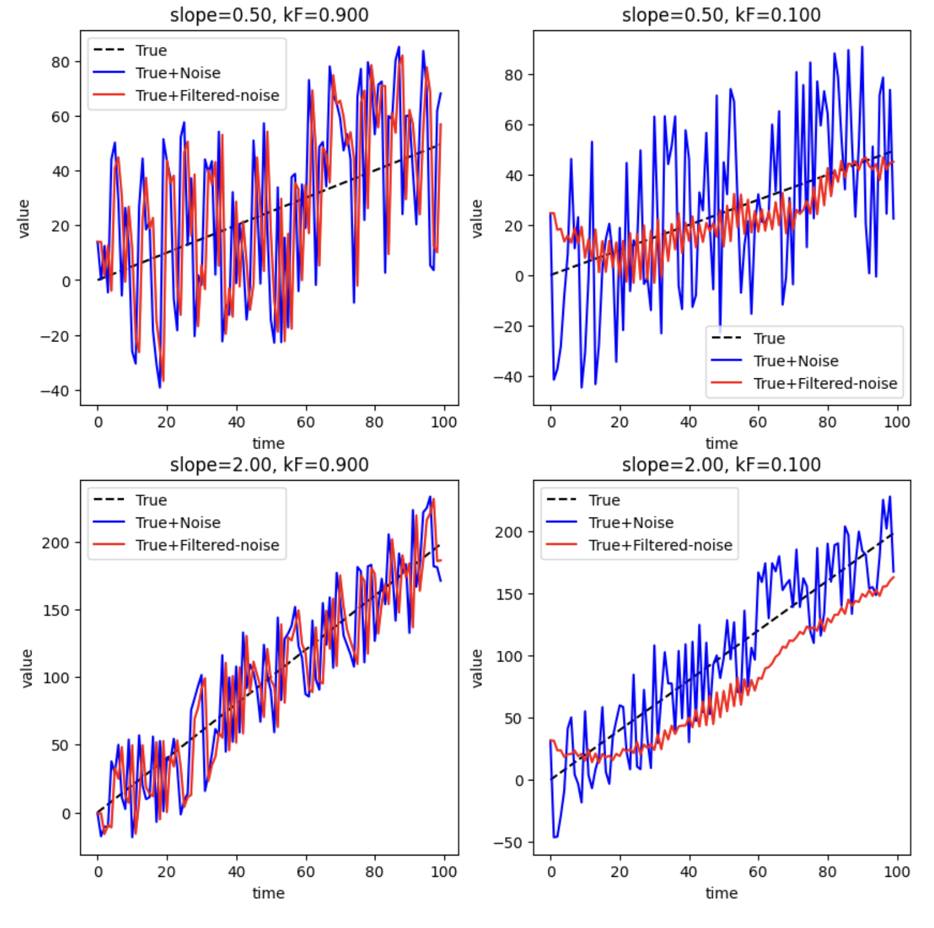






Filters
+
Controller
+
$$OLS$$
+
-
$$Filter$$
Discrete time
$$y(k)={k_{F}u\left(k\right)+\left(1−k_{F}\right)y(k−1)}_{}^{}$$
$$k_{F}∈[0,1]$$
Continuous time state equations
$$\dot{y}=k_{F}^{′}u−k_{F}^{′}y,$$
$$k_{F}^{′}>0$$
Rule of thumb:
Use small k_{F} for weak signal
Use large k_{F} for strong signal

Slide 4


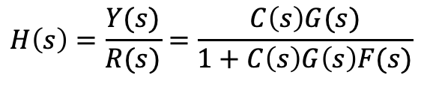





Filter Transfer Functions
Continuous time state equations
R(s)
E(s)
Y(s)
$$\dot{y}=au−by,$$
+
C(s)
+
$$G(s)$$
+
-
Transfer Function
F(s)
$$sY\left(s\right)=aU\left(s\right)−bY(s)$$
$$F(s)=\frac{a}{s+b}$$
Why must $a=b?$
Closed Loop Transfer Function
$$E\left(s\right)C\left(s\right)G\left(s\right)=Y\left(s\right)$$
Observations
Filter affects DC gain
Filter affects root-locus branches
$$E\left(s\right)=R\left(s\right)−Y\left(s\right)F(s)$$
$$H\left(s\right)=\frac{Y(s)}{R(s)}=\frac{C\left(s\right)G(s)}{1+C\left(s\right)G\left(s\right)F(s)}$$

Slide 5
Control Design in the Frequency Domain
Frequency response
Frequency-domain control criteria
Frequency-domain control design

Slide 6
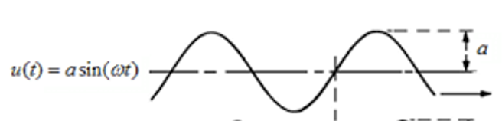
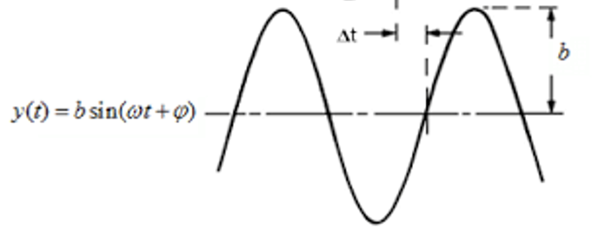

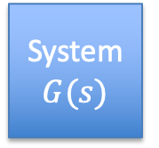

Frequency Response
$$u(t)$$
A sinusoid input to a linear system outputs a sinusoid at the same frequency but with changes in amplitude and phase.
System $G(s)$
y$(t)$

Slide 7
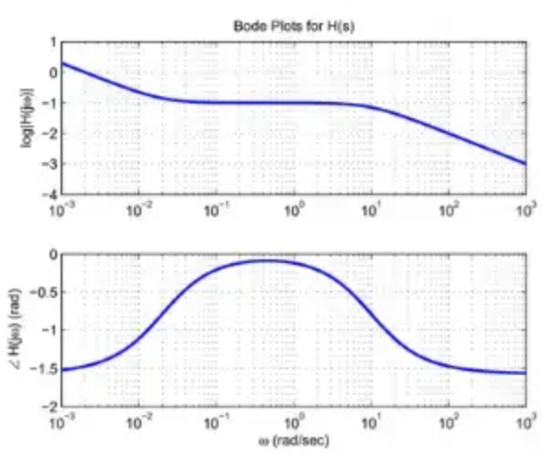
Bode Plot
A bode plot shows the response of a linear system to many frequencies of sinusoids (x-axis).
Amplitude response (top plot)
Phase lag (bottom plot)
The slope of the plots changes at “corner” frequencies that correspond to poles and zeros in the transfer function of the linear system.
amplitude
phase

Slide 8
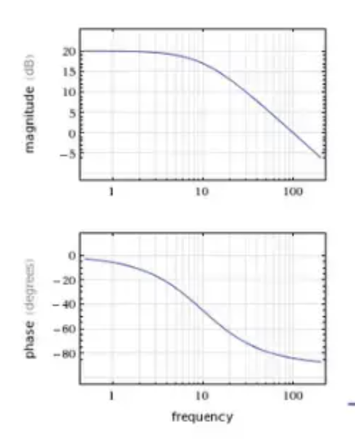
Why Bode Plots for Control Design?
Eliminating noise in control is equivalent to a low-pass filer.
Control design creates a desired low-pass filter.

Slide 9
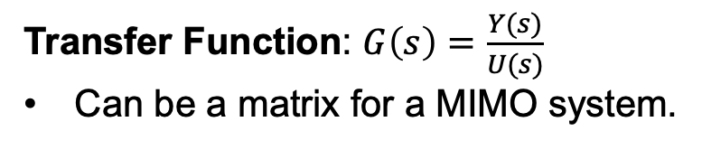

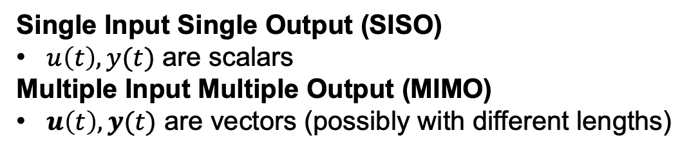



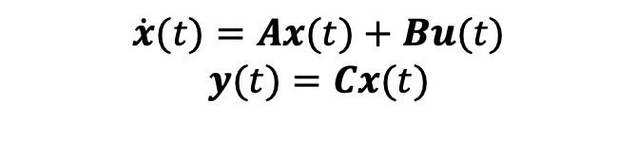
State Space Systems, SISO, MIMO
state
$$\dot{x}(t)$$
$$\dot{x}(t)=Ax(t)+Bu(t)$$
$$y(t)=Cx(t)$$
$$u(t)$$
$$x(t)$$
input
$$y(t)$$
System
output
Single Input Single Output (SISO)
$u\left(t\right), y(t)$ are scalars
Multiple Input Multiple Output (MIMO)
$u\left(t\right), y(t)$ are vectors (possibly with different lengths)
Transfer Function: $G\left(s\right)=\frac{Y(s)}{U(s)}$
Can be a matrix for a MIMO system.

Slide 10





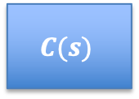



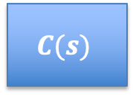








Examples of Closed Loop Systems
$$\dot{x}(t)$$
$$u(t)$$
state
$$x(t)$$
input
$$y(t)$$
System
output
SISO PID Design
$$R(s)$$
$$E(s)$$
$$U(s)$$
$$Y(s)$$
$$C(s)$$
$$G(s)$$
+
$$−$$
$$F(s)$$
SISO Full State Feedback
$$R(s)$$
$$U(s)$$
$$Y(s)$$
$$C(s)$$
$$G(s)$$
X$(s)$
Notes:
Note that X(s) is a vector

Slide 11
Controllability
$$\dot{x}(t)$$
$$u(t)$$
state
Defn: The system can be driven into any state in finite time by some combination of inputs.
$$x(t)$$
input
$$y(t)$$
System
output
S0 -> S1; k0*S0
S1 -> S2; k1*S1
S0 -> S1; k0*S0
If S0 is the input and S1 is the state, are there values of S0 so that we obtain arbitrary values of S1?
If S0 is the input and S1, S2 are the states, are there values of S0 so that we obtain arbitrary values of S2, S3?

Slide 12
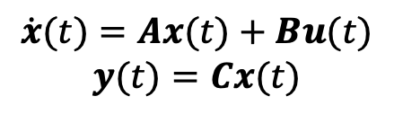
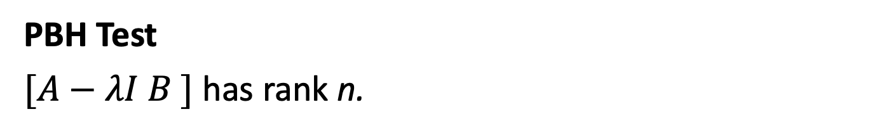
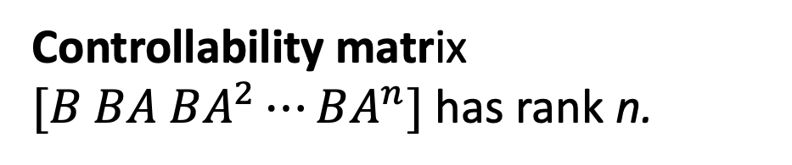
Tests for Controllability
$$\dot{x}(t)$$
$$u(t)$$
state
$$x(t)$$
input
$$y(t)$$
System
output
Controllability matrix $[B BA BA^{2}⋯BA^{n}]$ has rank n.
$$\dot{x}(t)=Ax(t)+Bu(t)$$
$$y(t)=Cx(t)$$
PBH Test
$[A−λI B ]$ has rank n.
Degree of controllability
Gramian

Slide 13
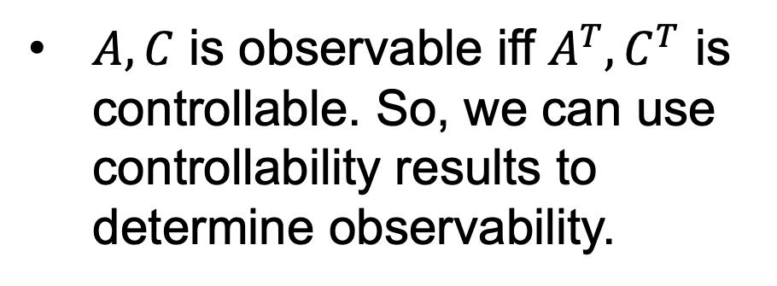
Observability
$$\dot{x}(t)$$
$$u(t)$$
state
$$x(t)$$
input
$$y(t)$$
Defn: Can estimate state from a time history of outputs.
System
output
$$\dot{x}(t)=Ax(t)+Bu(t)$$
$$y(t)=Cx(t)$$
$A, C$ is observable iff $A^{T},C^{T}$ is controllable. So, we can use controllability results to determine observability.

Slide 14
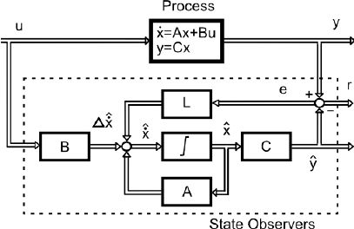
State Observers
$$\dot{x}(t)$$
$$u(t)$$
state
What do you do if you want to do full state feedback but you don’t have the full state?
$$x(t)$$
input
$$y(t)$$
System
output
$$\dot{x}(t)=Ax(t)+Bu(t)$$
$$y(t)=Cx(t)$$
State observers are feedbacks that estimate unknown internal state assuming an accurate linear model of the system.

Slide 15
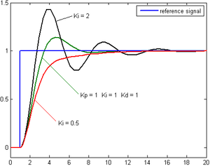
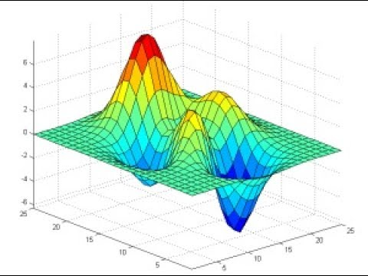
Optimal Control
Which controller design is best?
Optimal control
Define a cost function such that the lowest cost policy is “best”.
Controller has an optimizer that finds the lowest cost policy.

Slide 16


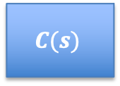











Design of An Optimal Controller
PID Controller
$$R(s)$$
$$E(s)$$
$$U(s)$$
$$Y(s)$$
$$C(s)$$
$$G(s)$$
+
$$−$$
$$F(s)$$
Optimal Controller
Optimizer
$$R(s)$$
$$E(s)$$
$$U(s)$$
$$Y(s)$$
Controller
$$G(s)$$
+
$$−$$
Model
$$F(s)$$

Slide 17
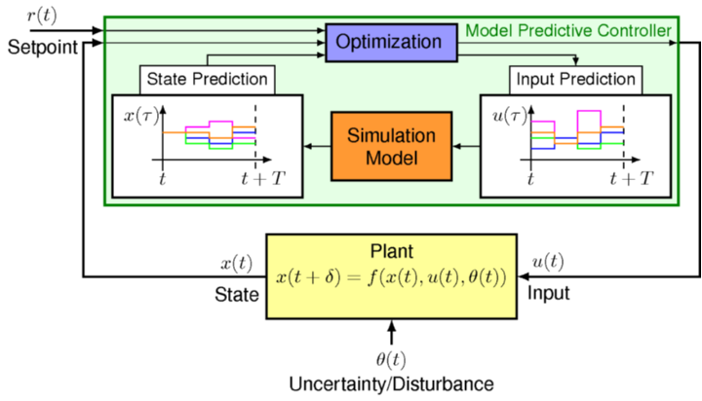
Model Predictive Control (MPC)
MPC adds to optimal control
Prediction over a short time horizon
Model updates
Recalculation of optimizations

Slide 18
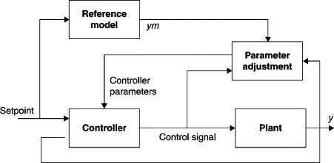
Adaptive Control
$$\dot{x}(t)$$
$$u(t)$$
state
$$x(t)$$
input
$$y(t)$$
What if the model of the system changes over time?
System
output
$$\dot{x}(t)=Ax(t)+Bu(t)$$
$$y(t)=Cx(t)$$
Adaptive control provides a way to dynamically update the model of the system by comparing predictive outputs with actual outputs.

Slide 19
Summary
Filter design
Frequency design
Controllability
Observability
Optimal control
Model predictive control
State Observers
Adaptive control
Notes:
Survey of Closed Loop Systems. Optimal control. Model predictive control. Controllability. Observability. Observers. Adaptive control. Fuzzy control.

